Slide 1
Chapter 12:
Theory of Computation

Slide 2
Chapter 12: Theory of Computation
12.1 Functions and Their Computation
12.2 Turing Machines
12.3 Universal Programming Languages
12.4 A Noncomputable Function
12.5 Complexity of Problems
12.6 Public-Key Cryptography

Slide 3
Functions
Function: A correspondence between a collection of possible input values and a collection of possible output values so that each possible input is assigned a single output

Slide 4
Functions (continued)
Computing a function: Determining the output value associated with a given set of input values
Noncomputable function: A function that cannot be computed by any algorithm

Slide 5
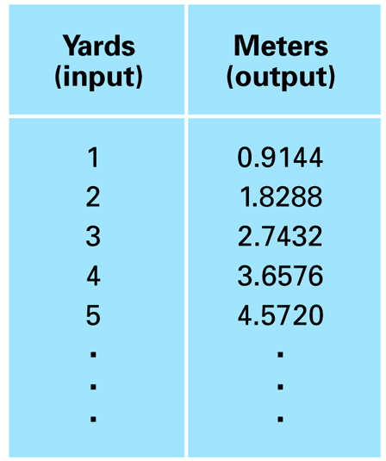
Figure 12.1 An attempt to display the function that converts measurements in yards into meters

Slide 6
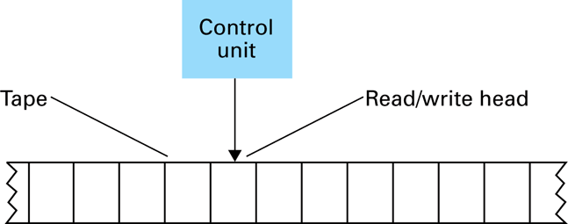
Figure 12.2 The components of a Turing machine

Slide 7
Turing Machine Operation
Inputs at each step
  State
  Value at current tape position
Actions at each step
  Write a value at current tape position
  Move read/write head
  Change state

Slide 8
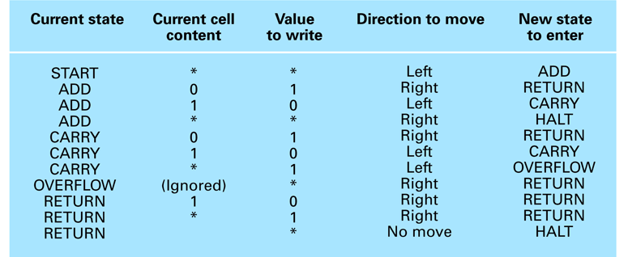
Figure 12.3 A Turing machine for incrementing a value

Slide 9
Church-Turing Thesis
The functions that are computable by a Turing machine are exactly the functions that can be computed by any algorithmic means.

Slide 10
Universal Programming Language
A language with which a solution to any computable function can be expressed
  Examples: “Bare Bones” and most popular programming languages

Slide 11
The Bare Bones Language
Bare Bones is a simple, yet universal language.
Statements
  clear name;
  incr name;
  decr name;
  while name not 0 do; … end;

Slide 12
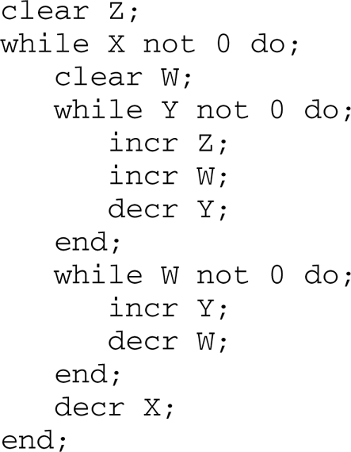
Figure 12.4 A Bare Bones program for computing X x Y

Slide 13
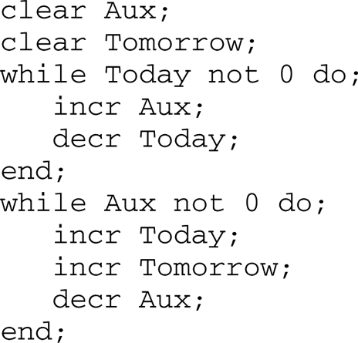
Figure 12.5 A Bare Bones implementation of the instruction “copy Today to Tomorrow”

Slide 14
The Halting Problem
Given the encoded version of any program, return 1 if the program is self-terminating, or 0 if the program is not.

Slide 15
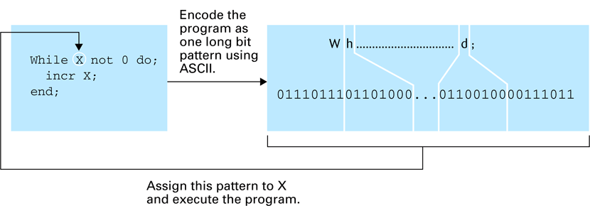
Figure 12.6 Testing a program for self-termination

Slide 16
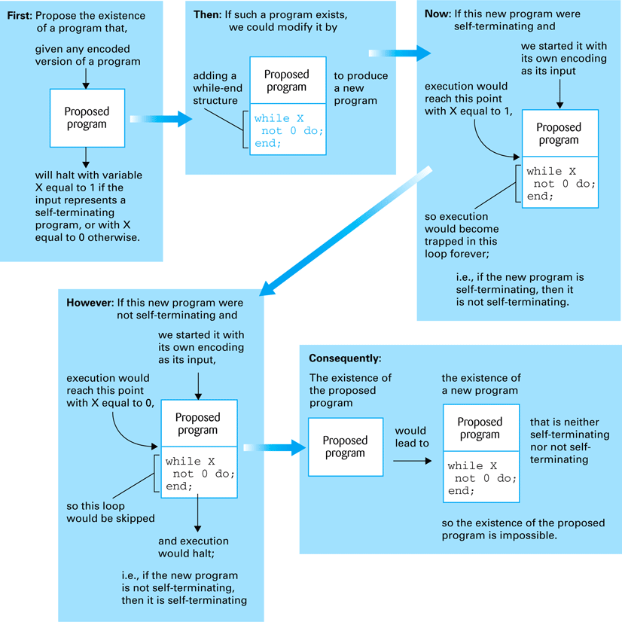
Figure 12.7 Proving the unsolvability of the halting program

Slide 17
Complexity of Problems
Time Complexity: The number of instruction executions required
  Unless otherwise noted, “complexity” means “time complexity.”
A problem is in class O(f(n)) if it can be solved by an algorithm in Θ(f(n)).
A problem is in class Θ(f(n)) if the best algorithm to solve it is in class Θ(f(n)).

Slide 18
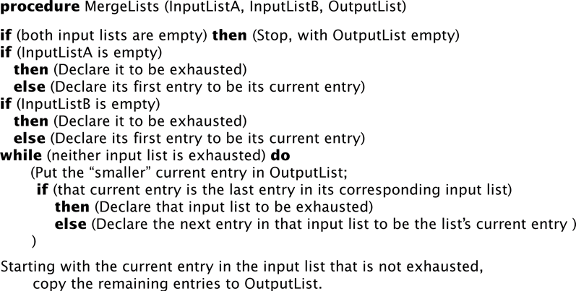
Figure 12.8 A procedure MergeLists for merging two lists

Slide 19
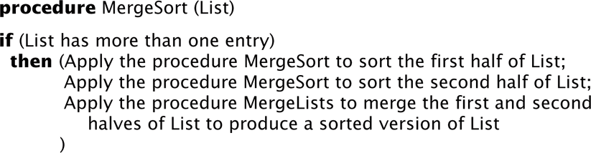
Figure 12.9 The merge sort algorithm implemented as a procedure MergeSort

Slide 20
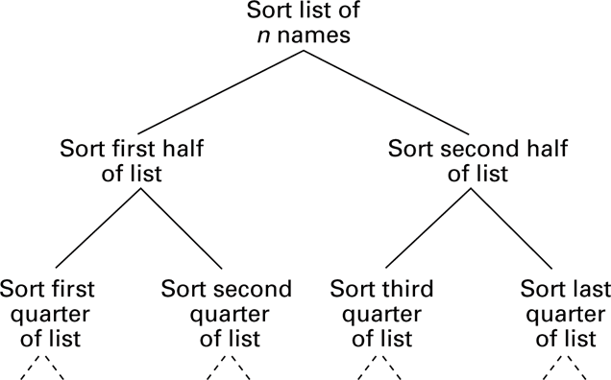
Figure 12.10 The hierarchy of problems generated by the merge sort algorithm

Slide 21
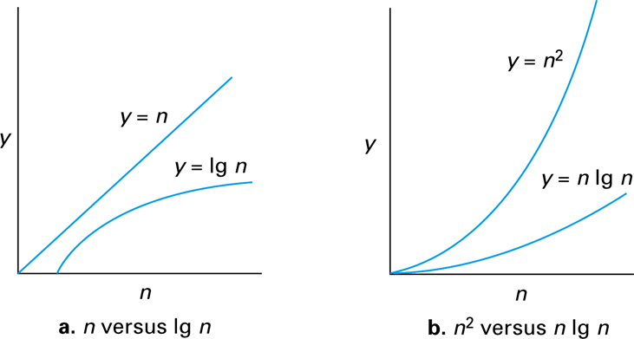
Figure 12.11 Graphs of the mathematical expressions n, lg n, n lg n, and n²

Slide 22
P versus NP
Class P: All problems in any class Θ(f(n)), where f(n) is a polynomial
Class NP: All problems that can be solved by a nondeterministic algorithm in polynomial time
  Nondeterministic algorithm = an “algorithm” whose steps may not be uniquely and completely determined by the process state
Whether the class NP is bigger than class P is currently unknown.

Slide 23
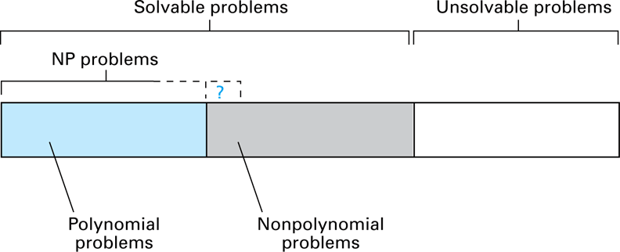
Figure 12.12 A graphic summation of the problem classification

Slide 24
Public-Key Cryptography
Key: A value used to encrypt or decrypt a message
  Public key: Used to encrypt messages
  Private key: Used to decrypt messages
RSA: A popular public key cryptographic algorithm
  Relies on the (presumed) intractability of the problem of factoring large numbers

Slide 25
Encrypting the Message 10111
Encrypting keys: n = 91 and e = 5
10111_{two} = 23_{ten}
23e = 23⁵ = 6,436,343
6,436,343 ÷ 91 has a remainder of 4
4_{ten} = 100_{two}
Therefore, encrypted version of 10111 is 100.

Slide 26
Decrypting the Message 100
Decrypting keys: d = 29, n = 91
100_{two} = 4_{ten}
4^{d} = 4²⁹ = 288,230,376,151,711,744
288,230,376,151,711,744 ÷ 91 has a remainder of 23
23_{ten} = 10111_{two}
Therefore, decrypted version of 100 is 10111.

Slide 27
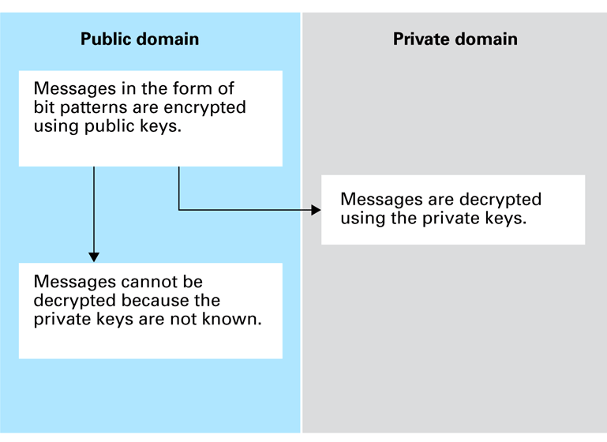
Figure 12.13 Public key cryptography

Slide 28
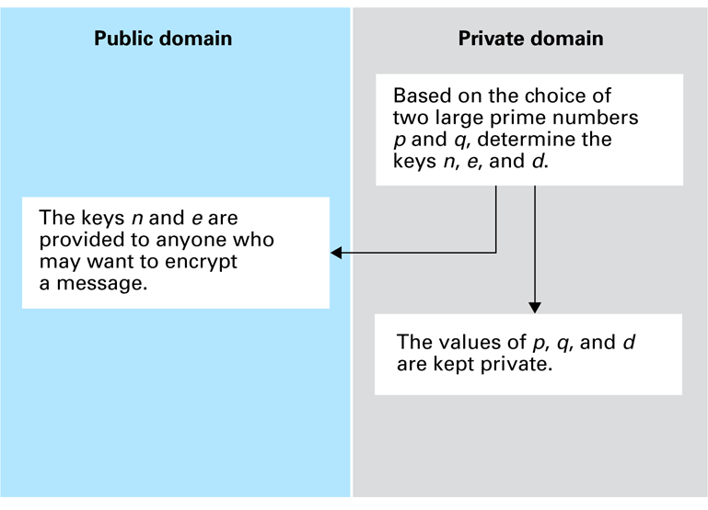
Figure 12.14 Establishing an RSA public key encryption system

